Slide 1
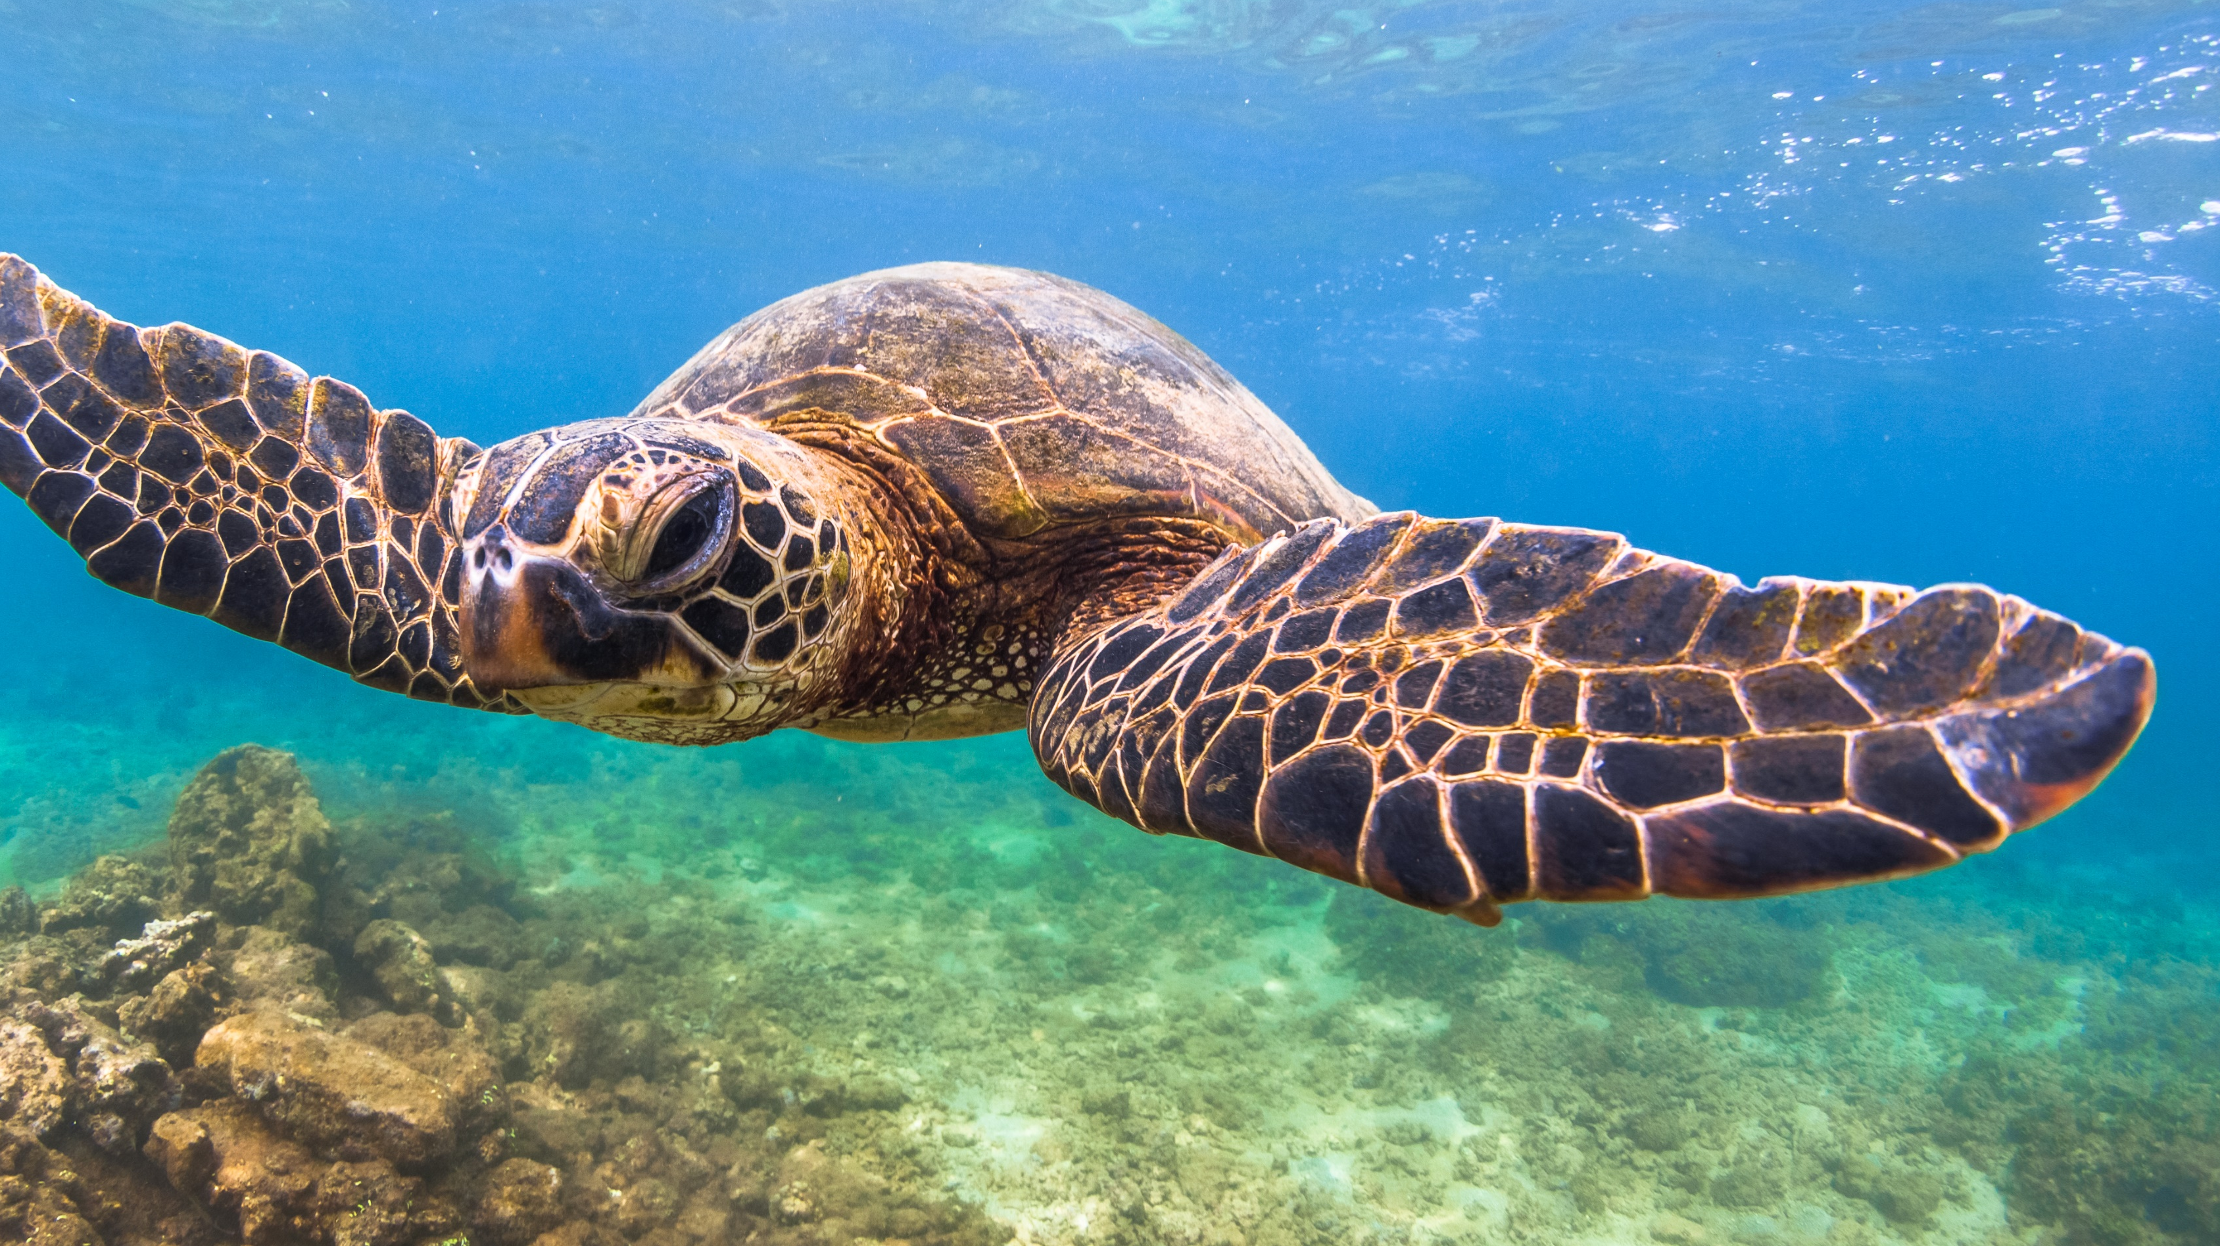
What’s Next for EnvA?
2024-2025
A management committee decision and dependent on resources, but my thoughts……

Slide 2
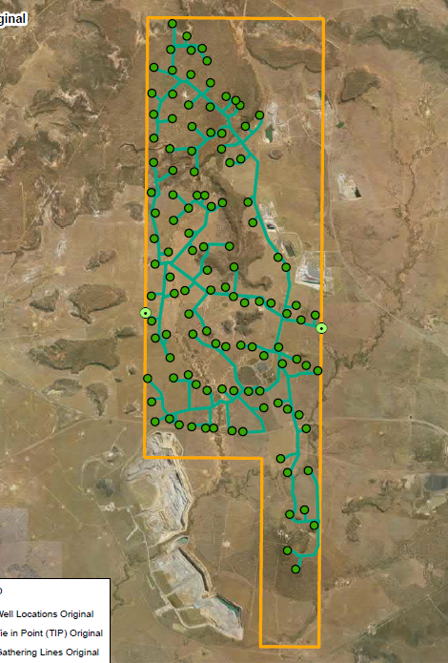
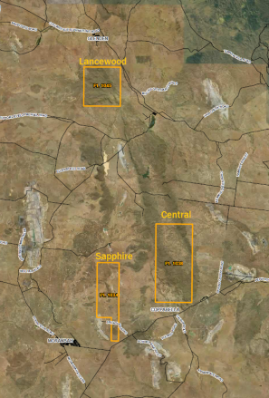
Keep Blue Energy out of CQ
Continue our legal challenge
The Land Court process is expected to be finalised by May 2025.
Hopeful the Land Court rules in our favor, but if not, we will need to review the decision and decide whether to take the challenge to the Supreme Court.
Where we can, we will also make submissions and comment on other coal seam gas projects in our region.

Slide 3
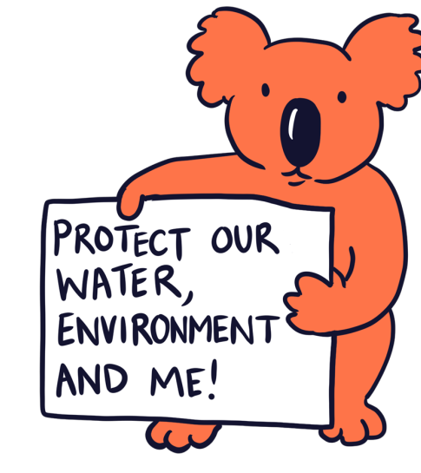
Koalas not Coal
Koko to take a lead role at events and in social media.
At least one event based on ‘koalas not coal’ – maybe a float at Pinefest.
Social and general media where koalas will be significantly impacted by coal mines.
Continue involvement in the National Koala Recovery Action Plan.

Slide 4
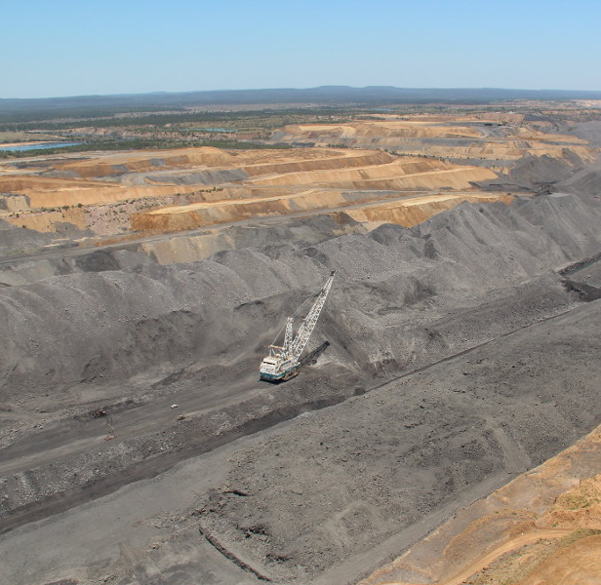
No new coal or gas
Continue to make submissions on as many proposed coal and gas projects as possible.
Maintain our role in regular:
  CQ Coal catchups,
  Meetings with DESI on CQ coal mines,
  Meetings with the Queensland Mine Rehabilitation Commissioner, and
  Consultation with the Reef Water Quality Improvement taskforce.
And maybe take on another legal challenge against a coal project!

Slide 5
Fixing legislation and policy
Contribute to the EPBC review and make it easy for everyone to have input.
Continue to write to decision-makers when the processes aren’t protecting the environment.
Write to welcome the next Qld Environment Minister and make sure they are aware of our issues with Queensland’s legislation and policy.
Contribute submissions to any amendments to legislation, policy and guidelines related to EnvA’s campaigns. (i.e. the Mining lease objections review).
Please fix the legislation and policies that are killing us!

Slide 6
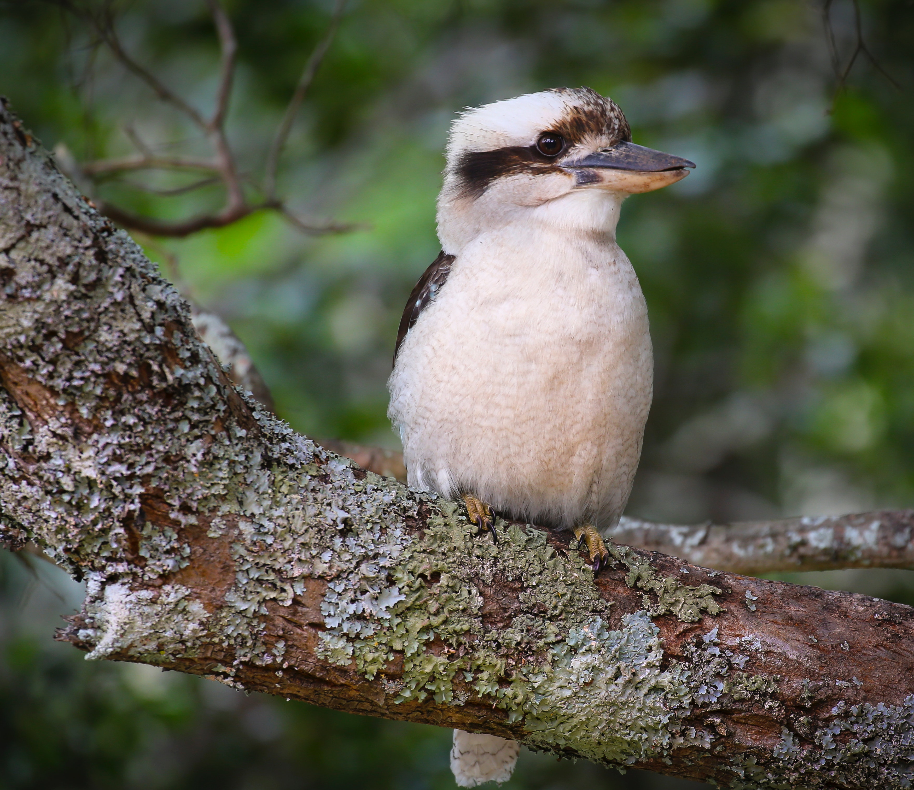

Thank you again to everyone who has supported EnvA in our journey to change “what is” to “what should be.”
We look forward to your support as we continue to grow and become an even louder voice for our environment.

